Slide 1
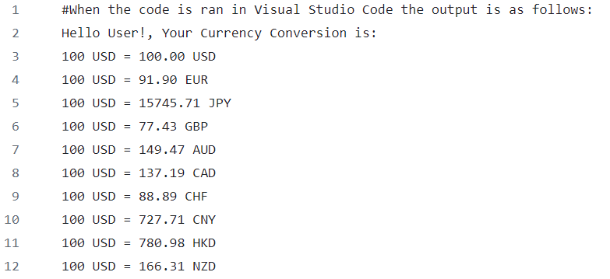

Currency Converter
A quick and easy way to convert currency using multiple worldwide currencies. Using a base amount of 100 USD, the consumer can find the conversion rate for the top 10 currencies: USD, EUR, JPY, GBP, AUD, CAD, CHF, CNY, HKD, and NZD.
Taylor Bates
This code was run using Python (3.11.7)

